Slide 1

CS4225/CS5425 Big Data Systems for Data Science
MapReduce
Bryan Hooi
School of Computing
National University of Singapore
bhooi@comp.nus.edu.sg

Slide 2
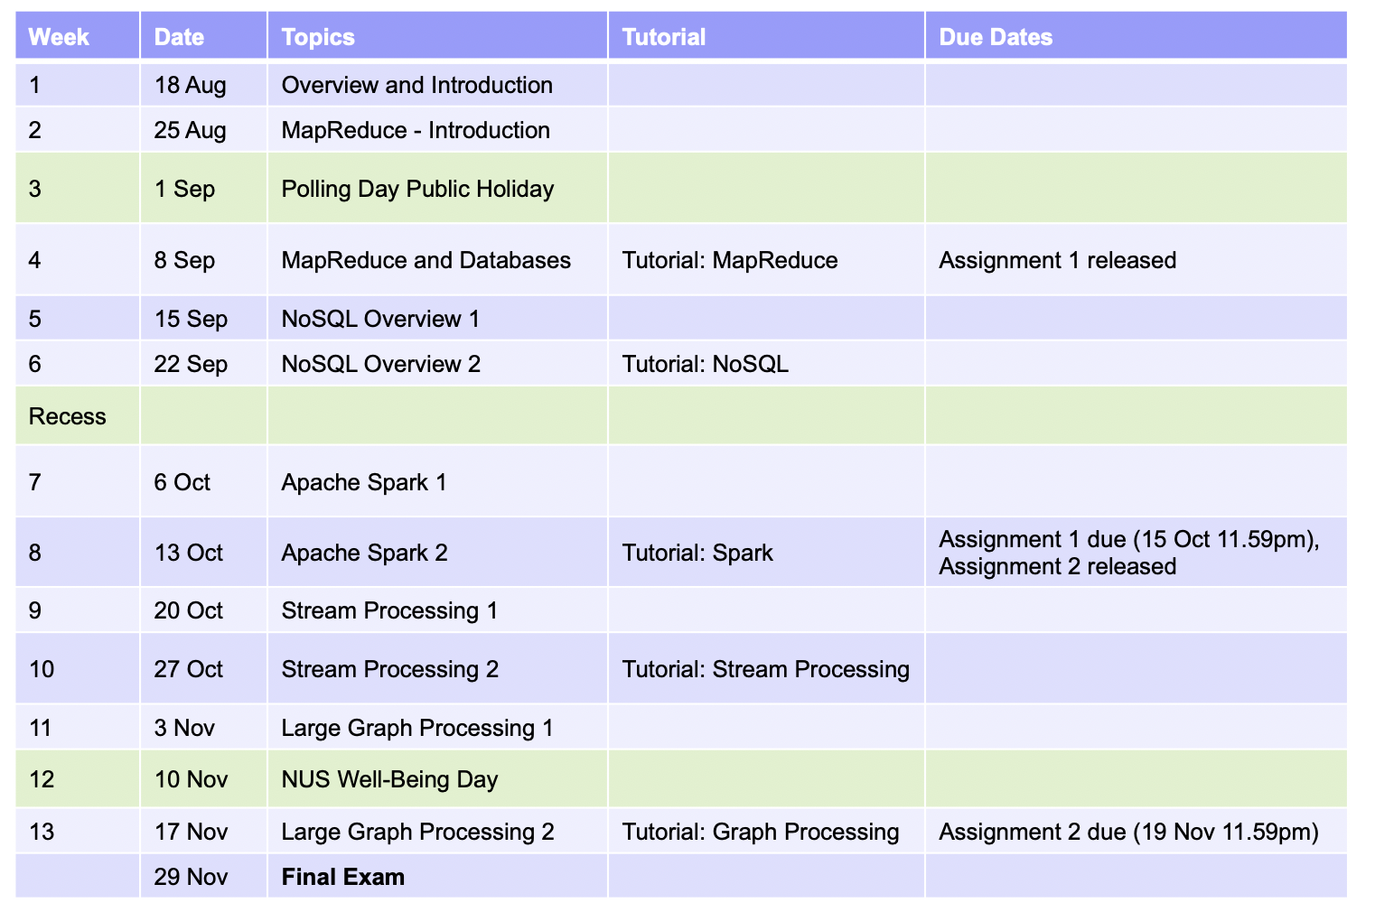
Announcements
No lecture next week
My office hours: Fri 2pm - 3pm in COM3-02-22, or Zoom (https://nus-sg.zoom.us/j/8351366217?pwd=RTNDU1dtY0VKVGx0YmpvLzF1T1ZsQT09)
Tutorials will also be recorded (links will be on Canvas home page, same with the lectures)

Slide 3
Review: Virtualization and Containers
App
App
App
App
App
App
OS
OS
Bin/libs
Bin/libs
Operating System
Hypervisor
Operating System
Hardware
Hardware
Hardware
Traditional Stack
Virtual Machines (VMs)
Containers
Virtual Machines: enable sharing of hardware resources by running each application in an isolated virtual machine.
High overhead as each VM has its own OS.
Containers: enable lightweight sharing of resources, as applications run in an isolated way, but still share the same OS.
A container is a lightweight software package that encapsulates an application and its environment.

Slide 4
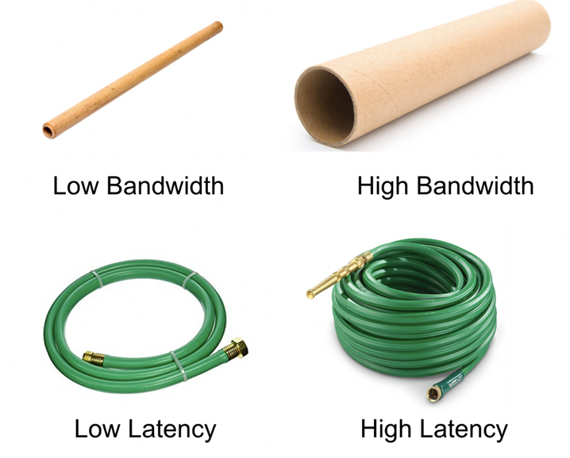
Recap: Bandwidth vs Latency
Bandwidth: maximum amount of data that can be transmitted per unit time (e.g. in GB/s)
Latency: time taken for 1 packet to go from source to destination (one-way) or from source to destination back to source (round trip), e.g. in ms
When transmitting a large amount of data, bandwidth tells us roughly how long the transmission will take.
When transmitting a very small amount of data, latency tells us how much delay there will be.
Throughput is similar to bandwidth, but instead of referring to capacity, it refers to the rate at which some data was actually transmitted across the network during some period of time.
Adding many lanes to a highway: increases bandwidth, but does not decrease latency
Credit: Katie Hempenius (via Jake Archibald)

Slide 5
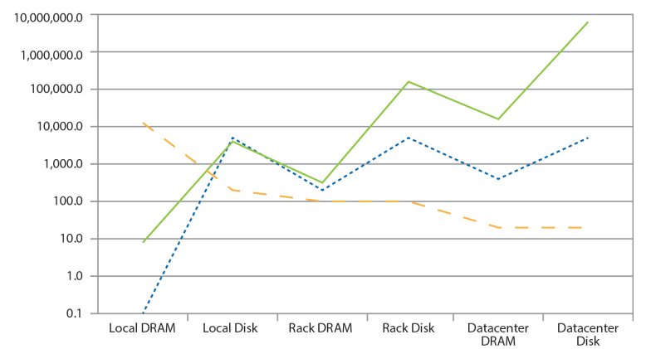
Recap: Cost of Moving Data Around Data Center
Capacity (GB)
Latency (µs)
Bandwidth (GB)
Disk reads are much more expensive than DRAM, both in terms of with higher latency and lower bandwidth.
Notes:
Clarify: meaning of “Rack DRAM” = move data to another machine on the same rack. “Datacenter DRAM” = on different rack.
Optional: for latency (blue line), moving from DRAM to disk is very slow, hence that is usually the bottleneck (flat parts of blue line)
For bandwidth, the bandwidth moving across the network (”switches” = networking devices in data center) are usually the bottleneck (flat parts of orange line)

Slide 6
Recap: Cost of Moving Data Around Data Center
Local
Rack
Data Center
Capacity (GB)
Latency (µs)
Bandwidth (GB)
Storage hierarchy: capacity increases as we go from Local Server to Rack to Datacenter. But, there are communication costs too (in Latency + Bandwidth)
Source: Barroso and Urs Hölzle (2013)
Notes:
Clarify: meaning of “Rack DRAM” = move data to another machine on the same rack. “Datacenter DRAM” = on different rack.
Optional: for latency (blue line), moving from DRAM to disk is very slow, hence that is usually the bottleneck (flat parts of blue line)
For bandwidth, the bandwidth moving across the network (”switches” = networking devices in data center) are usually the bottleneck (flat parts of orange line)

Slide 7
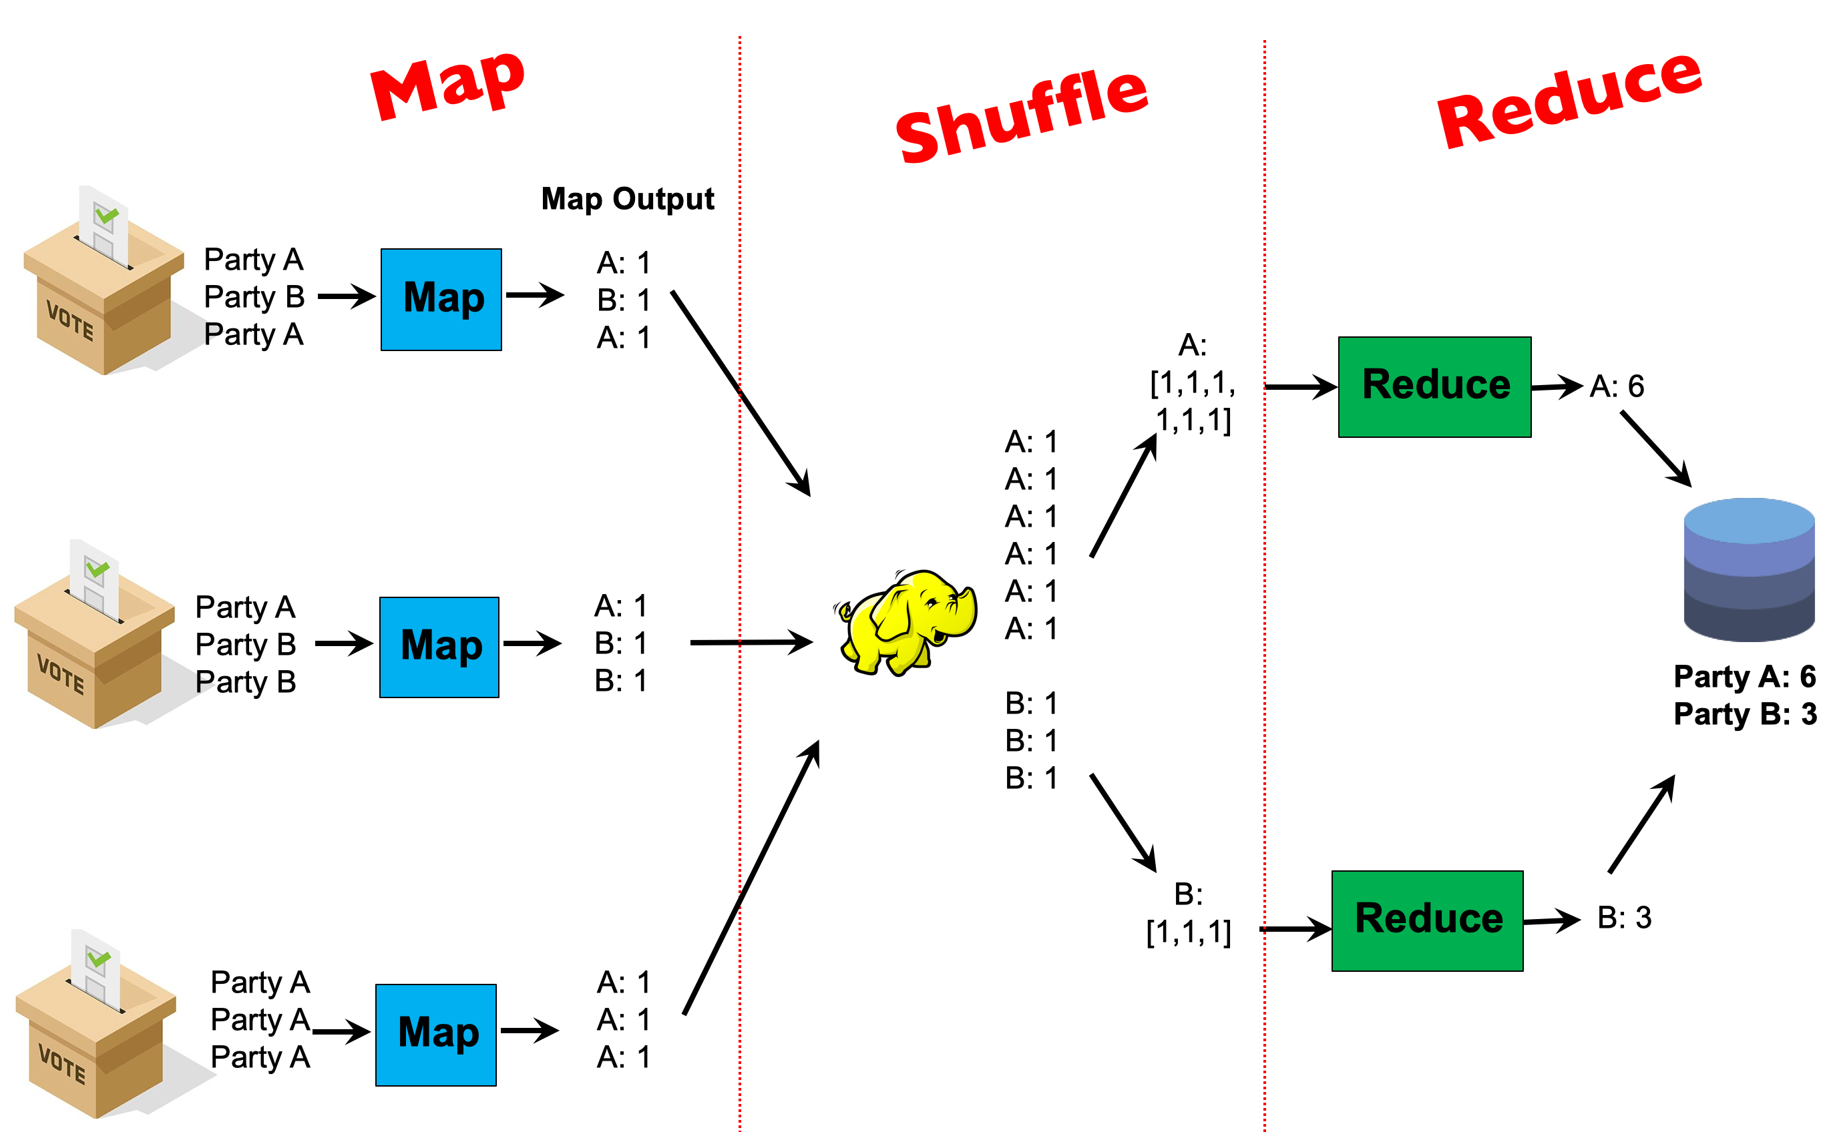
Recap: Writing MapReduce Programs
Typical Interface: Programmers specify two functions:
map (k₁, v₁) → List(k₂, v₂)
reduce (k₂, List(v₂)) → List(k₃, v₃)
All values with the same key are sent to the same reducer

Slide 8

MapReduce
Basic MapReduce
Partition and Combiner
Examples
Secondary Sort
Hadoop File System
Source: Google

Slide 9
MapReduce Implementation
User Program
(1) submit
Master
(2) schedule map
(2) schedule reduce
worker
split 0
(6) write
output
file 0
split 1
(5) remote read
worker
split 2
(3) read
(4) local write
split 3
worker
split 4
worker
output
file 1
worker
Input
files
Map
phase
Intermediate files
(on local disk)
Reduce
phase
Output
files
Shuffle phase
Notes:
1-2: User submits job to master, which schedules the map and reduce tasks
3: Input files are separated into “splits” of around 128MB each. Each split corresponds to one map task. Workers execute map tasks 1 at a time.
4: Worker processes all inputs <k,v> tuple in the split. For each tuple, the worker computes the map function, and write the intermediate outputs to its own local memory.
5: In reduce phase, each worker is responsible for 1 or more keys. For each key, it reads the data it needs from the corresponding partition of the mapper’s local disk. Recall the barrier: the reduce phase doesn’t start until map phase is complete
6: Reduce workers write output to HDFS

Slide 10
MapReduce Implementation
(1) Submit: user submits MapReduce program (including code for the map and reduce functions) and configuration (e.g. no. of workers) to Master node
(2) Schedule: Master schedules resources for map and reduce tasks
(Note: Master does not handle any actual data)
User Program
(1) submit
Master
(2) schedule map
(2) schedule reduce
worker
split 0
(6) write
output
file 0
split 1
(5) remote read
worker
split 2
(3) read
(4) local write
split 3
worker
split 4
worker
output
file 1
worker
Input
files
Map
phase
Intermediate files
(on local disk)
Reduce
phase
Output
files
Shuffle phase
Notes:
1-2: User submits job to master, which schedules the map and reduce tasks
3: Input files are separated into “splits” of around 128MB each. Each split corresponds to one map task. Workers execute map tasks 1 at a time.
4: Worker processes all inputs <k,v> tuple in the split. For each tuple, the worker computes the map function, and write the intermediate outputs to its own local memory.
5: In reduce phase, each worker is responsible for 1 or more keys. For each key, it reads the data it needs from the corresponding partition of the mapper’s local disk. Recall the barrier: the reduce phase doesn’t start until map phase is complete
6: Reduce workers write output to HDFS

Slide 11
MapReduce Implementation
(3) Read: Input files are separated into “splits” of around 128MB each. Each split corresponds to one map task. Workers execute map tasks 1 at a time.
User Program
(1) submit
Master
(2) schedule map
(2) schedule reduce
worker
split 0
(6) write
output
file 0
split 1
(5) remote read
worker
split 2
(3) read
(4) local write
split 3
worker
split 4
worker
output
file 1
worker
Input
files
Map
phase
Intermediate files
(on local disk)
Reduce
phase
Output
files
Shuffle phase
Notes:
Illustrate with example at bottom left (Party A, Party B, etc)
1-2: User submits job to master, which schedules the map and reduce tasks
3: Input files are separated into “splits” of around 128MB each. Each split corresponds to one map task. Workers execute map tasks 1 at a time.
4: Worker processes all inputs <k,v> tuple in the split. For each tuple, the worker computes the map function, and write the intermediate outputs to its own local memory.
5: In reduce phase, each worker is responsible for 1 or more keys. For each key, it reads the data it needs from the corresponding partition of the mapper’s local disk. Recall the barrier: the reduce phase doesn’t start until map phase is complete
6: Reduce workers write output to HDFS

Slide 12
MapReduce Implementation
Map phase: Each worker iterates over each <key, value> tuple in its input split, and computes the map function on each tuple
User Program
(1) submit
Master
(2) schedule map
(2) schedule reduce
worker
split 0
(6) write
output
file 0
split 1
(5) remote read
worker
split 2
(3) read
(4) local write
split 3
worker
split 4
worker
output
file 1
worker
Input
files
Map
phase
Intermediate files
(on local disk)
Reduce
phase
Output
files
Shuffle phase
Notes:
Illustrate with example at bottom left
1-2: User submits job to master, which schedules the map and reduce tasks
3: Input files are separated into “splits” of around 128MB each. Each split corresponds to one map task. Workers execute map tasks 1 at a time.
4: Worker processes all inputs <k,v> tuple in the split. For each tuple, the worker computes the map function, and write the intermediate outputs to its own local memory.
5: In reduce phase, each worker is responsible for 1 or more keys. For each key, it reads the data it needs from the corresponding partition of the mapper’s local disk. Recall the barrier: the reduce phase doesn’t start until map phase is complete
6: Reduce workers write output to HDFS

Slide 13
MapReduce Implementation
(4) Local write: Each worker writes the outputs of the map function to intermediate files on its own local disk. These files are partitioned by key (i.e. all the data for a single key is in one partition)
User Program
(1) submit
Master
(2) schedule map
(2) schedule reduce
worker
split 0
(6) write
output
file 0
split 1
(5) remote read
worker
split 2
(3) read
(4) local write
split 3
worker
split 4
worker
output
file 1
worker
Input
files
Map
phase
Intermediate files
(on local disk)
Reduce
phase
Output
files
Shuffle phase
Notes:
Illustrate with example at bottom left
1-2: User submits job to master, which schedules the map and reduce tasks
3: Input files are separated into “splits” of around 128MB each. Each split corresponds to one map task. Workers execute map tasks 1 at a time.
4: Worker processes all inputs <k,v> tuple in the split. For each tuple, the worker computes the map function, and write the intermediate outputs to its own local memory.
5: In reduce phase, each worker is responsible for 1 or more keys. For each key, it reads the data it needs from the corresponding partition of the mapper’s local disk. Recall the barrier: the reduce phase doesn’t start until map phase is complete
6: Reduce workers write output to HDFS

Slide 14
MapReduce Implementation
(5) Remote read: Each reduce worker is responsible for 1 or more keys. For each such key, it reads the data it needs from the corresponding partition of each mapper’s local disk.
User Program
(1) submit
Master
(2) schedule map
(2) schedule reduce
worker
split 0
(6) write
output
file 0
split 1
(5) remote read
worker
split 2
(3) read
(4) local write
split 3
worker
split 4
worker
output
file 1
worker
Input
files
Map
phase
Intermediate files
(on local disk)
Reduce
phase
Output
files
Shuffle phase
Notes:
Illustrate with example at bottom left
1-2: User submits job to master, which schedules the map and reduce tasks
3: Input files are separated into “splits” of around 128MB each. Each split corresponds to one map task. Workers execute map tasks 1 at a time.
4: Worker processes all inputs <k,v> tuple in the split. For each tuple, the worker computes the map function, and write the intermediate outputs to its own local memory.
5: In reduce phase, each worker is responsible for 1 or more keys. For each key, it reads the data it needs from the corresponding partition of the mapper’s local disk. Recall the barrier: the reduce phase doesn’t start until map phase is complete
6: Reduce workers write output to HDFS

Slide 15
MapReduce Implementation
Reduce phase: After receiving all the needed key value pairs, it computes the reduce function.
User Program
(1) submit
Master
(2) schedule map
(2) schedule reduce
worker
split 0
(6) write
output
file 0
split 1
(5) remote read
worker
split 2
(3) read
(4) local write
split 3
worker
split 4
worker
output
file 1
worker
Input
files
Map
phase
Intermediate files
(on local disk)
Reduce
phase
Output
files
Shuffle phase
Notes:
Illustrate with example at bottom left
1-2: User submits job to master, which schedules the map and reduce tasks
3: Input files are separated into “splits” of around 128MB each. Each split corresponds to one map task. Workers execute map tasks 1 at a time.
4: Worker processes all inputs <k,v> tuple in the split. For each tuple, the worker computes the map function, and write the intermediate outputs to its own local memory.
5: In reduce phase, each worker is responsible for 1 or more keys. For each key, it reads the data it needs from the corresponding partition of the mapper’s local disk. Recall the barrier: the reduce phase doesn’t start until map phase is complete
6: Reduce workers write output to HDFS

Slide 16
MapReduce Implementation
(6) Write: The output of the reduce function is written (usually to HDFS, a distributed file system)
User Program
(1) submit
Master
(2) schedule map
(2) schedule reduce
worker
split 0
(6) write
output
file 0
split 1
(5) remote read
worker
split 2
(3) read
(4) local write
split 3
worker
split 4
worker
output
file 1
worker
Input
files
Map
phase
Intermediate files
(on local disk)
Reduce
phase
Output
files
Shuffle phase
Notes:
Illustrate with example at bottom left
1-2: User submits job to master, which schedules the map and reduce tasks
3: Input files are separated into “splits” of around 128MB each. Each split corresponds to one map task. Workers execute map tasks 1 at a time.
4: Worker processes all inputs <k,v> tuple in the split. For each tuple, the worker computes the map function, and write the intermediate outputs to its own local memory.
5: In reduce phase, each worker is responsible for 1 or more keys. For each key, it reads the data it needs from the corresponding partition of the mapper’s local disk. Recall the barrier: the reduce phase doesn’t start until map phase is complete
6: Reduce workers write output to HDFS

Slide 17
MapReduce Implementation
Clarification of “shuffle phase”: the “shuffle phase” is comprised of the local write and remote read steps. Thus, it happens partly on the map workers, and partly on the reduce workers.
User Program
(1) submit
Master
(2) schedule map
(2) schedule reduce
worker
split 0
(6) write
output
file 0
split 1
(5) remote read
worker
split 2
(3) read
(4) local write
split 3
worker
split 4
worker
output
file 1
worker
Input
files
Map
phase
Intermediate files
(on local disk)
Reduce
phase
Output
files
Shuffle phase
Notes:
Illustrate with example at bottom left
1-2: User submits job to master, which schedules the map and reduce tasks
3: Input files are separated into “splits” of around 128MB each. Each split corresponds to one map task. Workers execute map tasks 1 at a time.
4: Worker processes all inputs <k,v> tuple in the split. For each tuple, the worker computes the map function, and write the intermediate outputs to its own local memory.
5: In reduce phase, each worker is responsible for 1 or more keys. For each key, it reads the data it needs from the corresponding partition of the mapper’s local disk. Recall the barrier: the reduce phase doesn’t start until map phase is complete
6: Reduce workers write output to HDFS

Slide 18
MapReduce Implementation
User Program
(1) submit
Master
(2) schedule map
(2) schedule reduce
worker
split 0
(6) write
output
file 0
split 1
(5) remote read
worker
split 2
(3) read
(4) local write
split 3
worker
split 4
worker
output
file 1
worker
Input
files
Map
phase
Intermediate files
(on local disk)
Reduce
phase
Output
files
Q: What disadvantages are there if the size of each split (or chunk) is too big or small?
Adapted from (Dean and Ghemawat, OSDI 2004)

Slide 19
MapReduce Implementation
User Program
(1) submit
Master
(2) schedule map
(2) schedule reduce
worker
split 0
(6) write
output
file 0
split 1
(5) remote read
worker
split 2
(3) read
(4) local write
split 3
worker
split 4
worker
output
file 1
worker
Input
files
Map
phase
Intermediate files
(on local disk)
Reduce
phase
Output
files
Q: What disadvantages are there if the size of each split (or chunk) is too big or small?
A: Too big: limited parallelism. Too small: high overhead (master node may be overwhelmed by scheduling work)
Adapted from (Dean and Ghemawat, OSDI 2004)

Slide 20
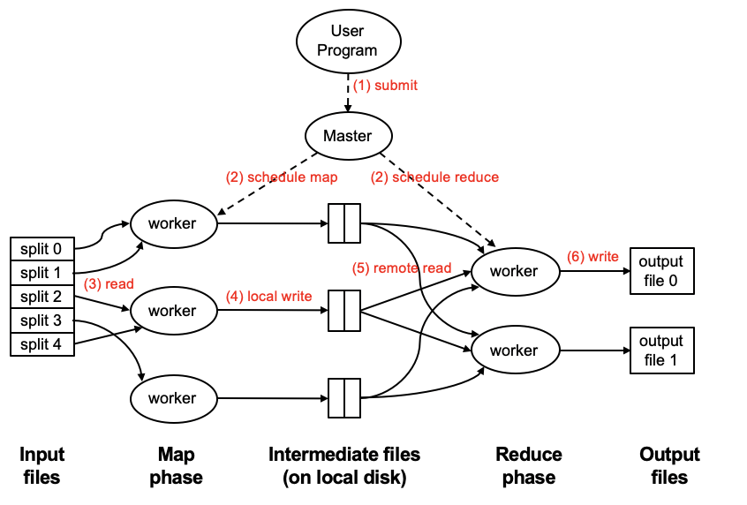
Important Clarifications: Map Task, Mapper, Map Function?
These terms can get confusing, please be clear on them
A worker is a component of the cluster that performs storage and processing tasks (you can loosely think of it as a physical machine)
Map Task is a basic unit of work; it is typically 128MB. At the beginning the input is broken into splits of 128MB. A map task is a job requiring to process one split; not a worker.
A single worker can handle multiple map tasks. Typically, when a worker completes a map task (e.g. split 0), it is re-assigned to another task (e.g. split 3)

Slide 21
Important Clarifications: Map Task, Mapper, Map Function?
A “mapper” or “reducer” will generally refer to the process executing a map or reduce task, not to physical machines / workers.
E.g. in this diagram there are 5 map tasks, and thus 5 mappers, but only 3 workers.

Slide 22
Important Clarifications: Map Task, Mapper, Map Function?
“Map Function” is a single call to the user-defined map (k₁, v₁) → List(k₂, v₂) function.
Note that a single map task can involve many calls to such a map function: e.g. within a 128MB split, there will often be many (key, value) pairs, each of which will produce one call to a map function.

Slide 23
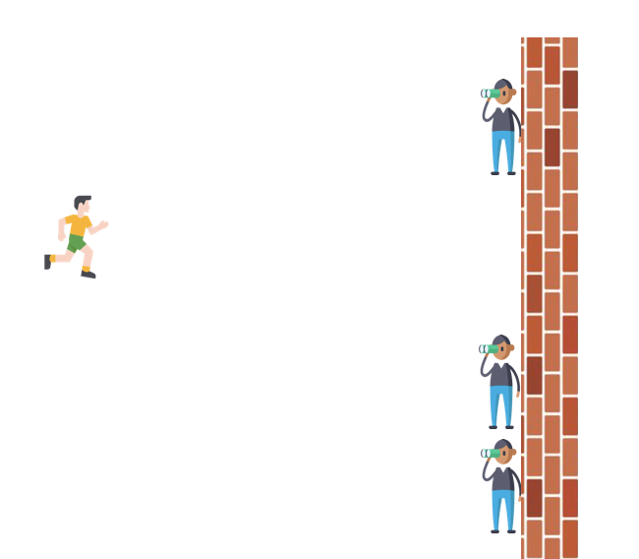
Two more details…
Barrier between map and reduce phases
Necessary, otherwise the reduce phase might compute the wrong answer
Note that the shuffle phase can begin copying intermediate data earlier
If a reduce task handles multiple keys, it will process these keys in sorted order

Slide 24
MapReduce
Basic MapReduce
Partition and Combiner
Examples
Secondary Sort
Hadoop File System
Source: Google
Notes:
Recall we are doing big data on data center or cluster.

Slide 25
Writing MapReduce Programs
Programmers specify two functions:
map (k₁, v₁) → List(k₂, v₂)
reduce (k₂, List(v₂)) → List(k₃, v₃)
All values with the same key are reduced together
The execution framework handles everything else…
Not quite…usually, programmers optionally also specify
partition, and combine functions
These are an optional optimization to reduce network traffic
Notes:
Besides Map and Reduce API, there are actually other APIs, such as
Partition
You can define how the data is partitioned in the shuffle and sort phase. Basically, it offers the flexibility of dividing up key space for parallel reductions.
2. Combine
Programmers can specify a combiner function running in the local memory after the map phase. It is often used as an optimization to reduce network traffic. We will give you some examples later.

Slide 26
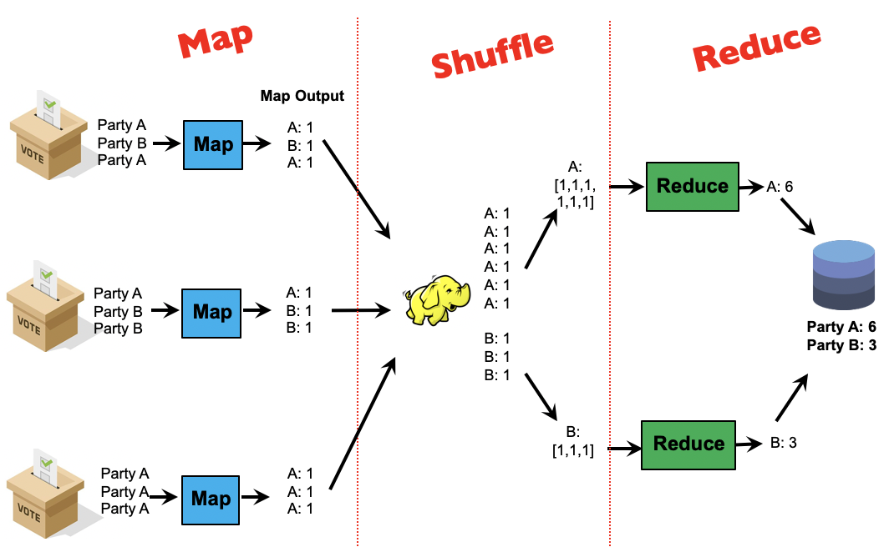
Partition Step
Note that key A went to reducer 1, and key B went to reducer 2
By default, the assignment of keys to reducers is determined by a hash function
e.g., key k goes to reducer: (hash(k) mod num_reducers)
%
0
1
2
…
9
key k
hash
1928782
mod 10
26

Slide 27
Partition Step
Note that key A went to reducer 1, and key B went to reducer 2
By default, the assignment of keys to reducers is determined by a hash function
e.g., key k goes to reducer: (hash(k) mod num_reducers)
User can optionally implement a custom partition, e.g. to better spread out the load among reducers (if some keys have much more values than others)
%
27

Slide 28
Combiner Step
Map
Reduce
Shuffle
Map Output
Party A
Party B
Party A
A: 1
B: 1
A: 1
Map
A: [1,1,1,1,1,1]
Reduce
A: 6
A: 1
A: 1
A: 1
A: 1
A: 1
A: 1
B: 1
B: 1
B: 1
Party A
Party B
Party B
A: 1
B: 1
B: 1
Map
Party A: 6
Party B: 3
B: [1,1,1]
Reduce
B: 3
Party A
Party A
Party A
A: 1
A: 1
A: 1
Map
28
Writing map output to disk is expensive! Can we reduce disk writes?

Slide 29
Combiner Step
Map
Shuffle
Reduce
Combiner Output
Party A
Party B
Party A
A: 1
B: 1
A: 1
A: 2
B: 1
Map
A: [2,1,3]
Reduce
A: 6
A: 2
A: 1
A: 3
B: 1
B: 2
Party A
Party A
Party B
A: 1
B: 1
B: 1
A: 1
B: 2
Map
Party A: 6
Party B: 3
B: [1,2]
Reduce
B: 3
Party A
Party A
Party A
A: 1
A: 1
A: 1
Map
A: 3
Combiners locally aggregate output from mappers.
Combiners are ‘mini-reducers’: in this example, combiners and reducers are the same function!
29

Slide 30
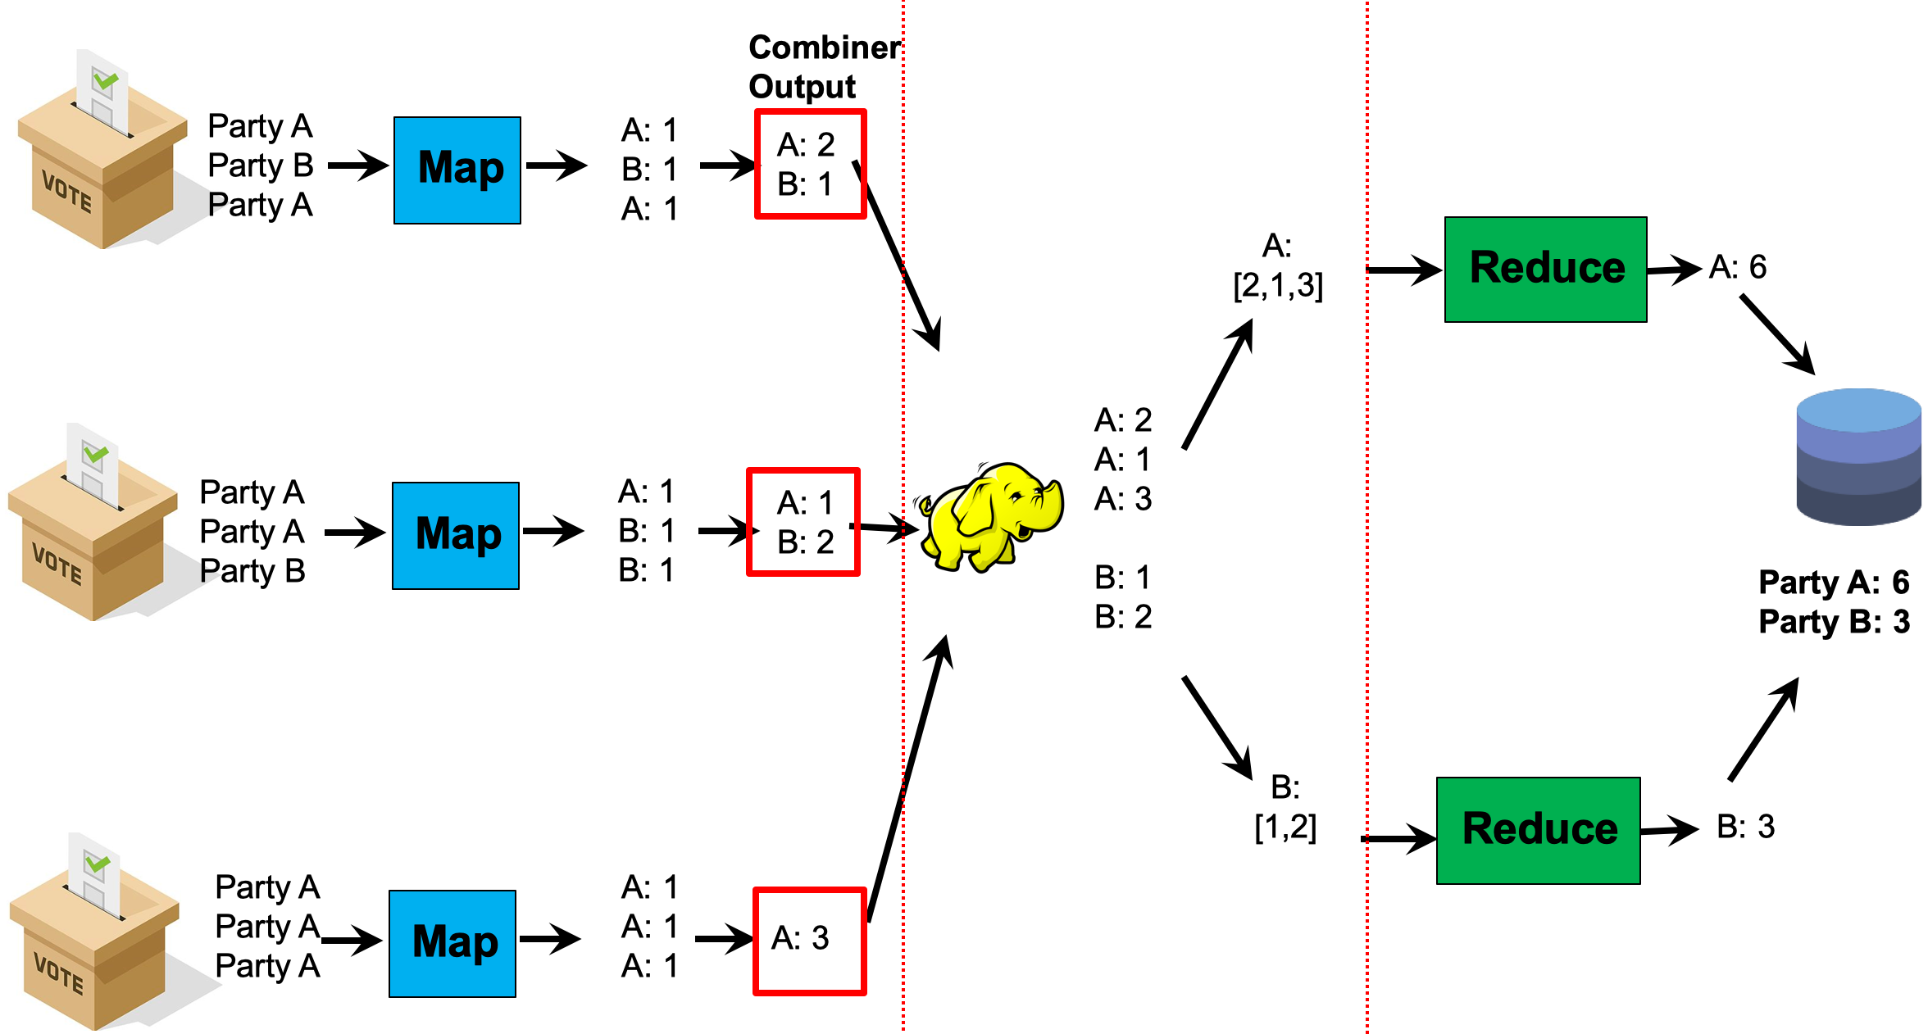
Correctness of Combiner
It is the user’s responsibility to ensure that the combiner does not affect the correctness of the final output, whether the combiner runs 0, 1, or multiple times
Example: in election example, the combiner and reducer are a “sum” over values with the same key. Summing can be done in any order without affecting correctness:
e.g. sum(sum(1, 1), 1, sum(1, 1, 1)) = sum(1, 1, 1, 1, 1, 1) = 6
The same holds for “max” and “min”
How about “mean” or “minus”?

Slide 31
Correctness of Combiner
It is the user’s responsibility to ensure that the combiner does not affect the correctness of the final output, whether the combiner runs 0, 1, or multiple times
Example: in election example, the combiner and reducer are a “sum” over values with the same key. Summing can be done in any order without affecting correctness:
e.g. sum(sum(1, 1), 1, sum(1, 1, 1)) = sum(1, 1, 1, 1, 1, 1) = 6
The same holds for “max” and “min”
How about “mean” or “minus”?
Answer: No! E.g. mean(mean(1, 1), 2) ≠ mean(1, 1, 2).
(Optional) In general, it is correct to use reducers as combiners if the reduction involves a binary operation (e.g. +) that is both
Associative: a + (b + c) = (a + b) + c
Commutative: a + b = b + a

Slide 32
MapReduce
Basic MapReduce
Partition and Combiner
Examples
Secondary Sort
Hadoop File System
Source: Google
Notes:
Recall we are doing big data on data center or cluster.

Slide 33
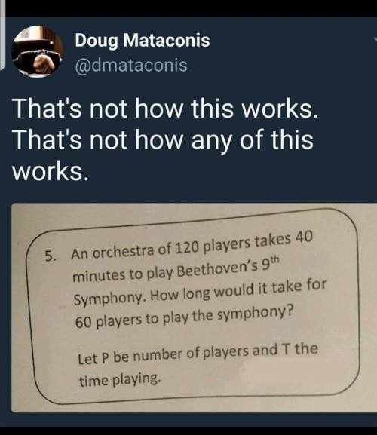
Performance Guidelines for Basic Algorithmic Design
Linear scalability: more nodes can do more work in the same time
Linear on data size
Linear on computer resources
Minimize disk and network I/O
Minimize disk I/O; sequential vs. random.
Minimize network I/O; send data in bulk vs in small chunks
Reduce memory working set of each task/worker
”Working set” = portion of memory that is actively being used during algorithm execution
Large working set -> high memory requirements / probability of out-of-memory errors.
Guidelines are applicable to Hadoop, Spark, …

Slide 34
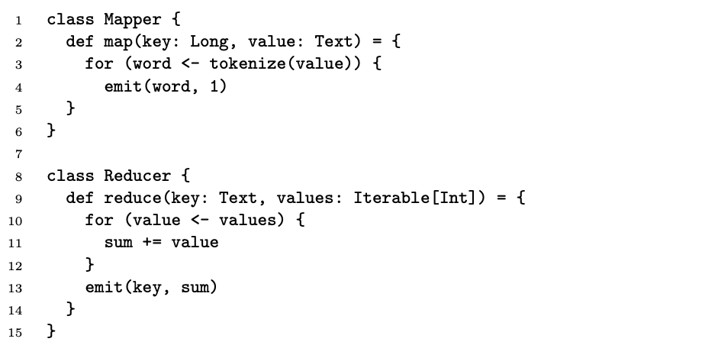
Word Count: Version 0
Input
key
value
0: the cat in the hat
1: it said to us,
2: …
128MB = 1 map task
This mapper processes each word one by one, and emits a “1”, to be summed by the reducers.
What’s the key problem of this program?
What’s the impact of combiners?
Notes:
Let’s demonstrate the usage of combiner and also how we can write the mapreduce program more efficiently.
This is a basic version from our hello world program.
Combiners help to combine all “1”s within a single machine for the same word.
What is the problem? Can we improve it?
Problem: we are sending too many “1”s in the network…
How to reduce the network traffic?

Slide 35
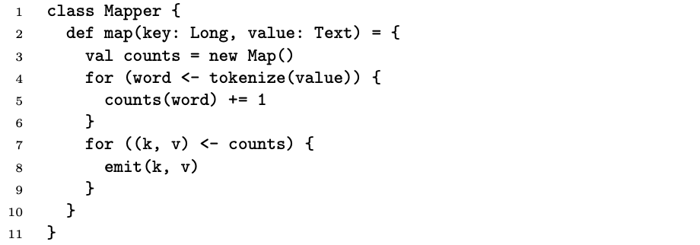
Word Count: Version 1
Input
key
value
Hash
table
0: the cat in the hat
1: it said to us,
2: …
128MB = 1 map task
This mapper uses a hash table (“counts”) to maintain the words and counts per line (i.e. in each call to the map function). After processing each line it emits the counts for this line.
Are combiners still of any use?
Notes:
Illustrate using example
The first approach is that we can use a data structure to maintain the word and the accumulative count for each word in the entire document.
You can consider this as a hash table data structure (associative array)->counts.
Then, the map will update counts, and emit the values stored in counts when finishing scan on each line.
Are the combiners still of any use?
What about partial results from different lines?

Slide 36
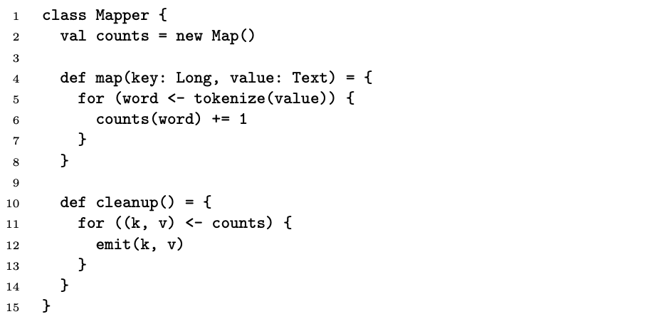
Word Count: Version 2
Input
key
value
0: the cat in the hat
1: it said to us,
2: …
128MB = 1 map task
Hash
table
This mapper uses a hash table to maintain the words and counts across all lines in a single split.
By aggregating tuples across map tasks, this reduces disk and memory I/O. However, a possible drawback is increasing the memory working set (which is proportional to the number of distinct words in a map task)
Notes:
Illustrate using example (contrast with prev case)
we can apply the hash table at the machine level… so we can build a hash table to maintain the state across input key-value pairs.
Basically, the word count is now tally across lines in the same task.
Common Question: when should we use regular combiners vs in memory combiners?
In some cases, using in-mapper combiners could lead to out-of-memory errors, so in that case regular combiners should be used.
Using combiners map be clearer from a code perspective (it communicates the user intent more easily)
Otherwise, either can be used, and the speedup should be similar, and for the purpose of this class the difference in speed between them can be ignored.
(In practice, there may be slight improved efficiency by using in-mapper combiners since the pairs are not even emitted to the Hadoop framework, but it is not likely to be that significant)

Slide 37
Preserving State in Map / Reduce Tasks
Mapper object
Reducer object
one object per task
state
state
setup
API initialization hook
setup
map
one call per input key-value pair
reduce
one call per intermediate key
cleanup
API cleanup hook
cleanup
Notes:
Recall that each map task and reduce task can process multiple key/value pairs… this diagram shows how we can maintain some stored state variables within a map/reduce task, across multiple map/reduce function calls.
To do this we define a mapper object, and then the mapper function can be called by this object, once per input key-value pair. The state is updated and maintained upon each function call.
During the execution of map/reduce, the state is updated.
After the mapper task is done, cleanup is needed, e.g., releasing the memory space.
“API initialization / cleanup hook” just means that the setup / cleanup functions will be called by Hadoop when the Mapper object is created / destroyed.

Slide 38
MapReduce
Basic MapReduce
Partition and Combiner
Examples
Secondary Sort
Hadoop File System
Source: Google
Notes:
Recall we are doing big data on data center or cluster.

Slide 39
Secondary Sort
Problem: each reducer’s values arrive unsorted. But what if we want them to be sorted (e.g. sorted by temperature)?
Solution: define a new ‘composite key’ as (K1, K2), where K1 is the original key (“Natural Key”) and K2 is the variable we want to use to sort
Partitioner: now needs to be customized, to partition by K1 only, not (K1, K2)
Notes:
Q: What if we want the reducer’s (key, value) pairs to arrive sorted by a variable (e.g. temperature)?
A: We must deﬁne a composite key (K1, K2), where K1 is the natural key and K2 is the variable we want to sort by.
Then we must also implement a custom partitioner, to ensure that we partition by K1 and not by (K1, K2).
Lastly, in the reducer, we need to preserve state across multiple key-value pairs to handle processing.
Illustrate with example on the left side

Slide 40
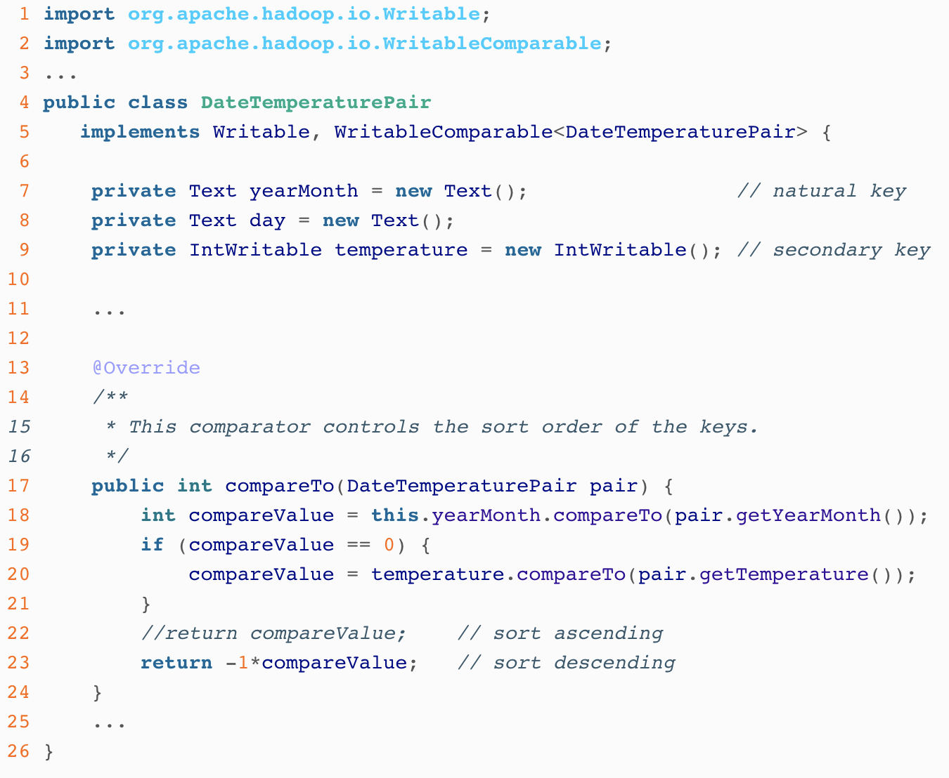
Code Example: Composite Key
Compare by yearMonth first; if tie, compare by temperature
Notes:
This code shows 1) composite key which is defined as (year, temperature) pair; 2) we need to specify the sort order of these pairs, i.e. that they should be sorted first by year, then by temperature.

Slide 41
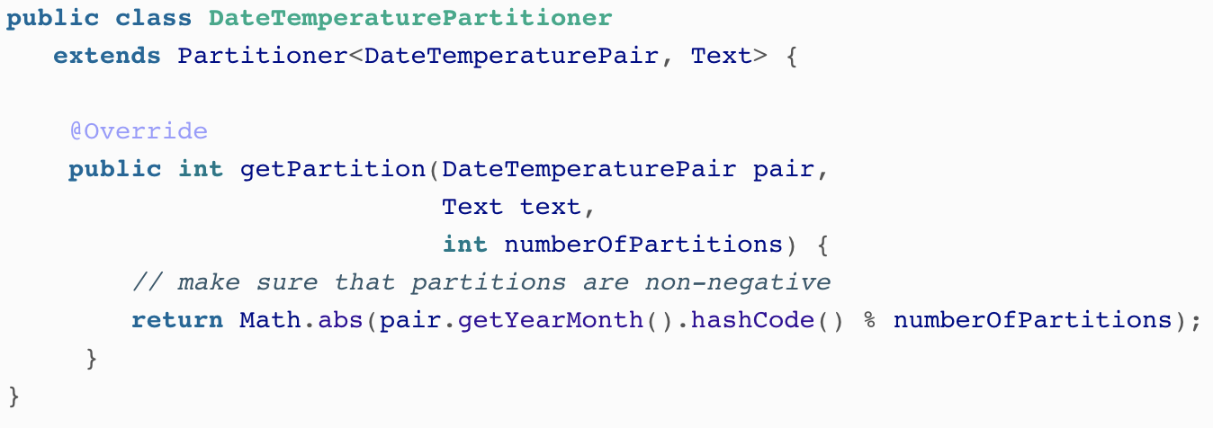
Code Example: Custom Partitioner
Partition by yearMonth only (not temperature)
Notes:
Then, we need to define the custom partition, to ensure that partitioning happens only by year, not by (year, temperature). So, all tuples with the same year will be processed by the same reduce task.

Slide 42
MapReduce
Basic MapReduce
Partition and Combiner
Examples
Secondary Sort
Hadoop File System
Source: Google
Notes:
Recall we are doing big data on data center or cluster.

Slide 43

How do we get data to the workers?
Storage Nodes
Network
Compute Nodes
What’s the problem here?
Notes:
Traditional supercomputer: separate data storage and computation.
Can we use this architecture? why not?
Moving data is costly in this environment. Also usually, the data processing in map/reduce is not very heavy. Thus, moving the data can easily become the bottleneck on this traditional architecture.

Slide 44
Distributed File System
Don’t move data to workers… move workers to the data!
Store data on the local disks of nodes in the cluster
Start up the workers on the node that has the data local
A distributed file system is the answer
GFS (Google File System) for Google’s MapReduce
HDFS (Hadoop Distributed File System) for Hadoop
Notes:
Rather than centralized file systems, we should use distributed file systems. Data are stored in different servers in a distributed manner. Therefore, do not move data to workers. We should move workers to data.
Store data on the local disks of nodes in the cluster
Start up the workers on the node that has the data local
There are a number of reasons (also benefits) of doing so:
DRAM is small and usually cannot hold the entire data set.
Network is slow.
Disk access is slow. But aggregated bandwidth is reasonable.
Therefore, DFS is the answer.
Google has GFS… the open-sourced version is called Hadoop DFS (HDFS). In the following, we introduce their high level ideas.

Slide 45
GFS / HDFS: Assumptions
Commodity hardware instead of “exotic” hardware
Scale “out”, not “up”
High component failure rates
Inexpensive commodity components fail all the time
“Modest” number of huge files
Files are write-once, mostly appended to
Large streaming reads instead of random access
High sustained throughput over low latency
GFS slides adapted from material by (Ghemawat et al., SOSP 2003)
Notes:
Assumptions (or, what GFS is good at)
Data centers:
It is for scale-out (thus data center environment), rather than supercomputers. Thus, it addresses both scale-out and failure.
Scale out is to aggregate the disk bandwidth to read the data in high speed.
Files/Data:
Good for huge files.
Access pattern:
Accesses patterns: sequential reads; write once, updates are mostly appended. It cares about throughput rather than latency.
Sequential reads: good for mapreduce.
Ideally that is good for Google’s workload… can you think of some tricky cases? What if small files like images? See “extending Mapreduce”

Slide 46
Design Decisions
Files stored as chunks
Fixed size (64MB for GFS, 128MB for HDFS)
Reliability through replication
Each chunk replicated across 3+ chunkservers
Single master to coordinate access, keep metadata
Simple centralized management
HDFS = GFS clone (same basic ideas)
Notes:
Before we present, can you match those design decisions for the assumptions?
Single master to coordinate access, keep metadata
Simplify the API
=> Only need to support modest number of huge files, and simplified access patterns.
Why chunking? Disk throughput is reasonable, although random access latency is bad.
Note: those are design decisions for Google… but when Hadoop/HDFS is used for many other applications, some decisions are relaxed.
For example:
Simplify the API
Push some of the issues onto the client (e.g., data layout)
//in GFS paper: “GFS provides a familiar file system interface, though it does not implement a standard API such as POSIX. Files are organized hierarchically in directories and identified by pathnames. We support the usual operations to create, delete, open, close, read, and write files”

Slide 47
HDFS Architecture
1. Send request to read data
HDFS namenode
Application
/foo/bar
(file name, block id)
File namespace
HDFS Client
block 3df2
(block id, block location)
2. Namenode searches file namespace, and directs request to datanode
Health monitoring, heartbeat, replication, etc.
instructions to datanode
(block id, byte range)
datanode state
HDFS datanode
HDFS datanode
block data
3. Client communicates with datanode to request and receive each file block
Linux file system
Linux file system
…
…
Q: How to perform replication when writing data?
Adapted from (Ghemawat et al., SOSP 2003)
Notes:
GFS master = Hadoop namenode
GFS chunkservers = Hadoop datanodes
There is an HDFS client for application to access HDFS.
How to get a data block? Step 1: send a request to namenode. Step 2: namenode will search the name space and directory, and direct the request to data node. Step 3: data node will send the data to the client.
Replication: when client writes data to a datanode, the namenode also decides which datanodes should be used as replicas, and same packets are forwarded to the 2nd and 3rd nodes in the pipeline

Slide 48
HDFS Architecture
1. Send request to read data
HDFS namenode
Application
/foo/bar
(file name, block id)
File namespace
HDFS Client
block 3df2
(block id, block location)
2. Namenode searches file namespace, and directs request to datanode
Health monitoring, heartbeat, replication, etc.
instructions to datanode
(block id, byte range)
datanode state
HDFS datanode
HDFS datanode
block data
3. Client communicates with datanode to request and receive each file block
Linux file system
Linux file system
…
…
Q: How to perform replication when writing data?
A: Namenode decides which datanodes are to be used as replicas. The 1st datanode forwards data blocks to the 1st replica, which forwards them to the 2nd replica, and so on.
Adapted from (Ghemawat et al., SOSP 2003)
Notes:
GFS master = Hadoop namenode
GFS chunkservers = Hadoop datanodes
There is an HDFS client for application to access HDFS.
How to get a data block? Step 1: send a request to namenode. Step 2: namenode will search the name space and directory, and direct the request to data node. Step 3: data node will send the data to the client.
Replication: when client writes data to a datanode, the namenode also decides which datanodes should be used as replicas, and same packets are forwarded to the 2nd and 3rd nodes in the pipeline

Slide 49
Namenode Responsibilities
Managing the file system namespace:
Holds file/directory structure, metadata, file-to-block mapping, access permissions, etc. Coordinating file operations:
Directs clients to datanodes for reads and writes
No data is moved through the namenode
Maintaining overall health:
Periodic communication with the datanodes
Block re-replication and rebalancing
Garbage collection
Q: What if the namenode’s data is lost?
Notes:
No data is moved through the namenode: move task to data.
Block re-replication and rebalancing: for load balancing (after a while for deletions and etc)
Garbage collection: fragmentation may be caused upon deletions. reclaim the space for new files.
No data is moved through the namenode

Slide 50
Namenode Responsibilities
Managing the file system namespace:
Holds file/directory structure, metadata, file-to-block mapping, access permissions, etc. Coordinating file operations:
Directs clients to datanodes for reads and writes
No data is moved through the namenode
Maintaining overall health:
Periodic communication with the datanodes
Block re-replication and rebalancing
Garbage collection
Q: What if the namenode’s data is lost?
A: All files on the filesystem cannot be retrieved since there is no way to reconstruct them from the raw block data. Fortunately, Hadoop provides 2 ways of improving resilience, through backups and secondary namenodes (out of syllabus, but you can refer to Resources for details)
Notes:
No data is moved through the namenode: move task to data.
Block re-replication and rebalancing: for load balancing (after a while for deletions and etc)
Garbage collection: fragmentation may be caused upon deletions. reclaim the space for new files.
No data is moved through the namenode

Slide 51
Putting everything together…
Namenode for HDFS
Master node for Hadoop runtime
namenode
job submission node
namenode daemon
jobtracker
Worker nodes for Hadoop runtime
tasktracker
tasktracker
tasktracker
Datanodes for HDFS
datanode daemon
datanode daemon
datanode daemon
Linux file system
Linux file system
Linux file system
…
…
…
slave node
slave node
slave node
Notes:
Combine Hadoop and HDFS together:
Job tracker/task tracker for Hadoop runtime
Namenode daemon and datanote daemon for HDFS.
Namenode and job submission node can be the same or different machine.
Again, there are many improvements over this basic architecture… recent one is YARN… we will cover this later.
https://hadoop.apache.org/docs/r2.7.2/hadoop-yarn/hadoop-yarn-site/YARN.html
The fundamental idea of YARN is to split up the functionalities of resource management and job scheduling/monitoring into separate daemons. The idea is to have a global ResourceManager (RM) and per-application ApplicationMaster (AM). An application is either a single job or a DAG of jobs.

Slide 52
Q: Which statement(s) about Hadooop’s partitioner is true?
The partitioner determines which keys are processed on which mappers.
The partitioner can improve performance when some keys are much more common than others.
The partitioner is run in between the map and reduce phases.

Slide 53
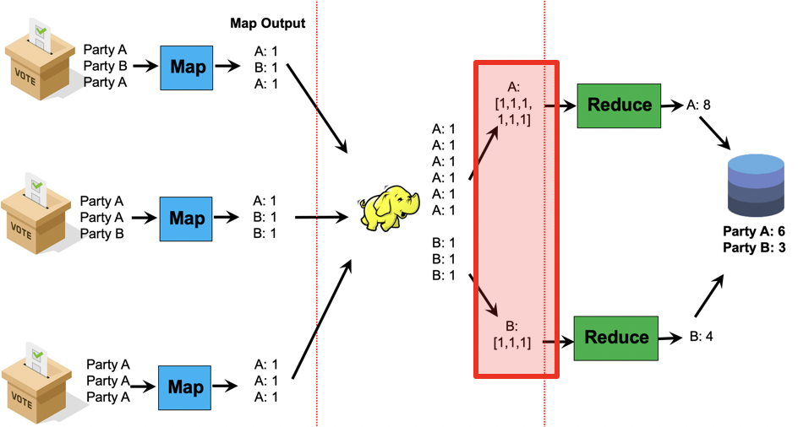
Q: Which statement(s) about Hadooop’s partitioner is true?
The partitioner determines which keys are processed on which mappers.
The partitioner can improve performance when some keys are much more common than others.
The partitioner is run in between the map and reduce phases.
A: 2 and 3

Slide 54
Q: True or false: the Shuffle stage of MapReduce is always run within a single node.
True
False

Slide 55
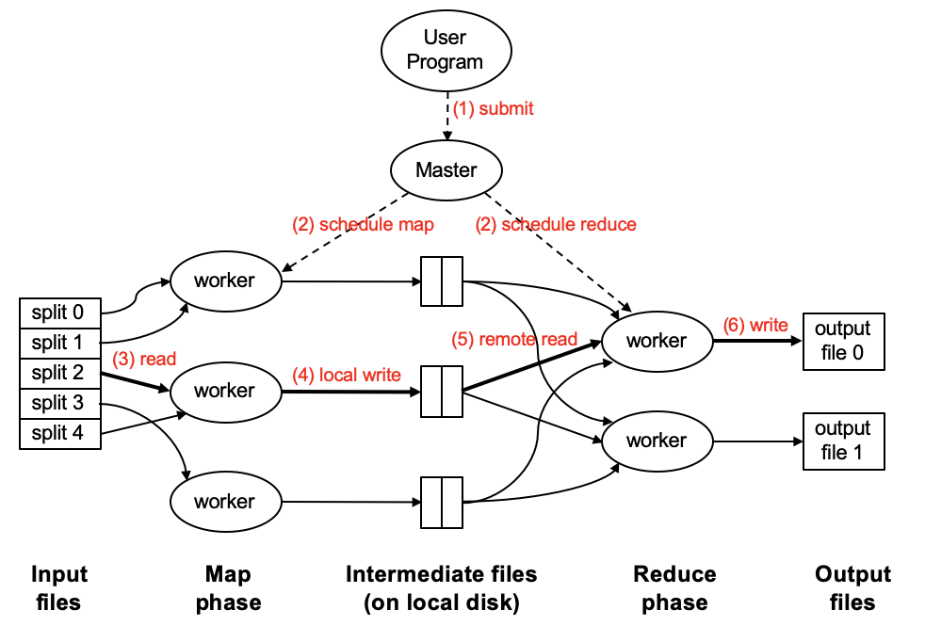
Q: True or false: the Shuffle stage of MapReduce is always run within a single node.
True
False
A: False (it runs in the worker nodes)

Slide 56
Resources
Hadoop: The Definitive Guide (by Tom White)
Hadoop Wiki
https://hadoop.apache.org/docs/current/
YARN
https://hadoop.apache.org/docs/current/hadoop-yarn/hadoop-yarn-site/YARN.html

Slide 57
Acknowledgement
Slides adopted/revised from
Jimmy Lin, http://lintool.github.io/UMD-courses/bigdata-2015-Spring/
He Bingsheng
Some slides are also adopted/revised from
Claudia Hauff, TU Delft: https://chauff.github.io/
Jure Leskovec, Anand Rajaraman, and Jeffrey David Ullman. 2014. Mining of Massive Datasets (2nd ed.). Cambridge University Press. http://www.mmds.org/

